Slide 1
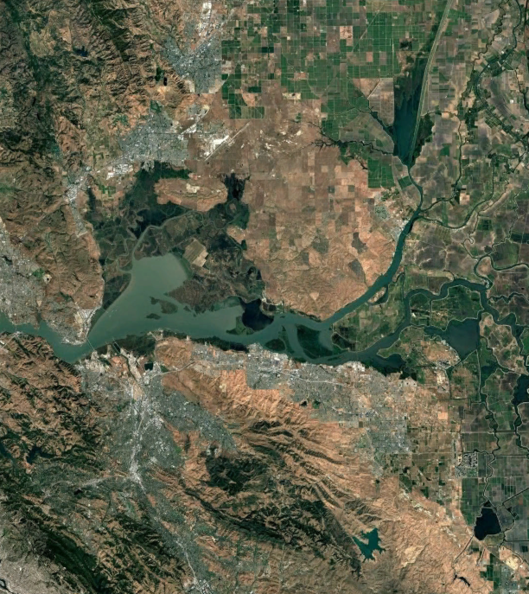
Gear Comparison of Predator Removal Efforts at Clifton Court Forebay
Danny Cox
DWR – Fisheries Infrastructure and
Operations Branch

Slide 2
Outline
Predator relocation efforts
Data limitations
Modeling
Questions

Slide 3
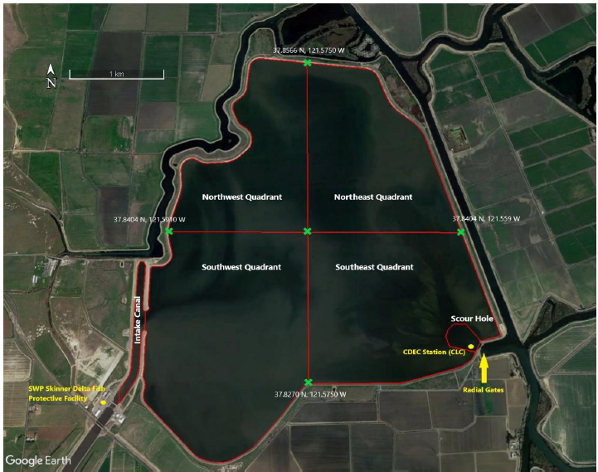
Predator Relocation Efforts at Clifton Court Forebay

Slide 4
Predator Relocation Efforts at Clifton Court Forebay
Predator Reduction Electrofishing Study
2016 – 2018
Electrofishing
Predatory Fish Removal Study
2019 – 2020
Beach seine, hoop trap, fyke trap, Kodiak trawl
Enhanced Predatory Fish Removal and Relocation Study
2021 – 2023
Electrofishing, beach seine, hoop trap, fyke trap, hook-and-line

Slide 5
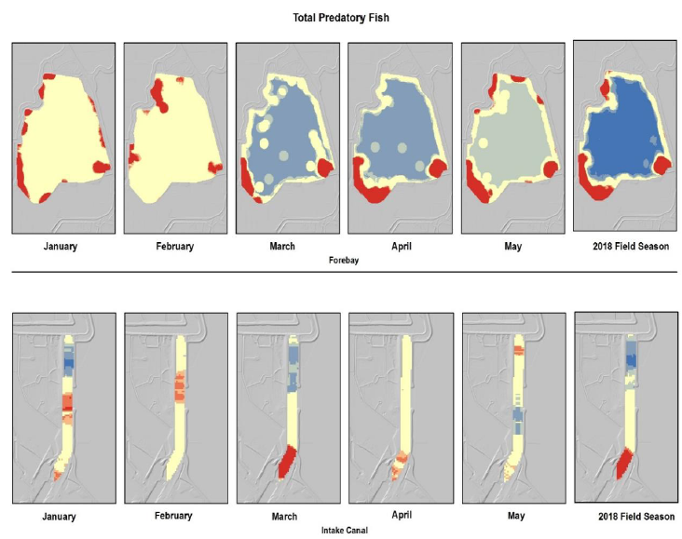
Predator Relocation Efforts at Clifton Court Forebay
Electrofishing

Slide 6
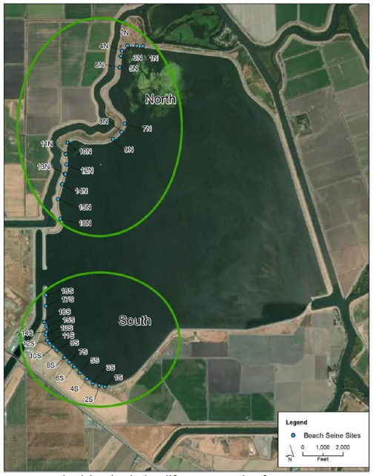
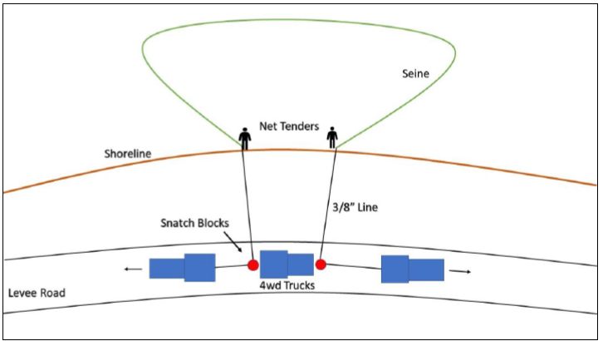
Predator Relocation Efforts at Clifton Court Forebay
Beach seine
Beach seine sites in 2021

Slide 7
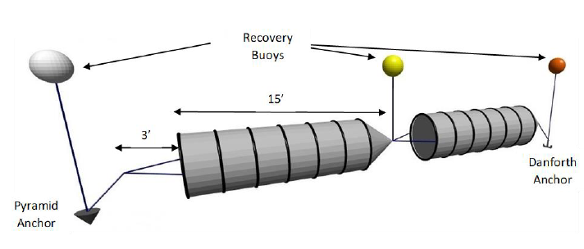
Predator Relocation Efforts at Clifton Court Forebay
Hoop traps

Slide 8
Predator Relocation Efforts at Clifton Court Forebay
2017
2018
2019
2020
2021
2022
2023
2016
PRES
PFRS
EPFRRS
Electrofishing
Beach Seine
Hoop Trap
Fyke Trap
Kodiak
Lampara
Electrofishing
Beach Seine
Hoop Trap
Kodiak
Hook and Line

Slide 9
Data limitations
Sparse data exists for most species
Selected 5 most abundant for this analysis

Slide 10
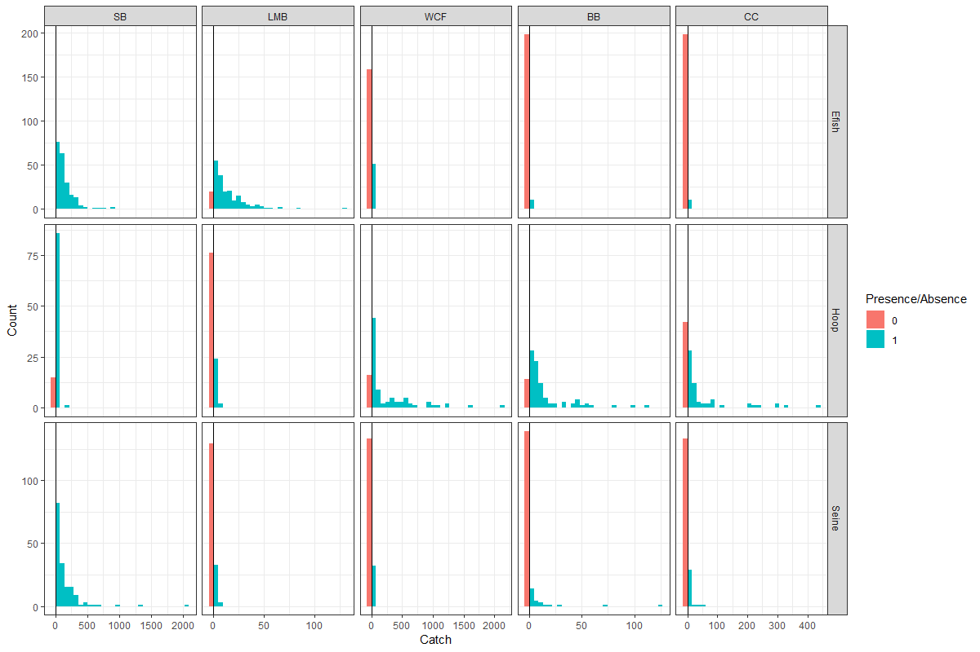
Data limitations
SB – Striped bass
LMB – Largemouth bass
WCF – White Catfish
BB – Brown Bullhead Catfish
CC – Channel Catfish
Heiss, Andrew. 2022.
“A Guide to Modeling Outcomes
That Have Lots of Zeros with
Bayesian Hurdle Lognormal and
Hurdle Gaussian Regression
Models.” May 9, 2022.
https://doi.org/10.59350/ety2j-09566.

Slide 11
Data limitations
Sparse data existed for certain species
Covariates such as Location and Depth were inconsistent across gear types

Slide 12
Data limitations
(diagrams of locations and depths)

Slide 13
Data limitations
Sparse data existed for certain species
Covariates such as Location and Depth were inconsistent across gear types
Fish counts occurred on different scale from collection

Slide 14
Fish Processing

Slide 15
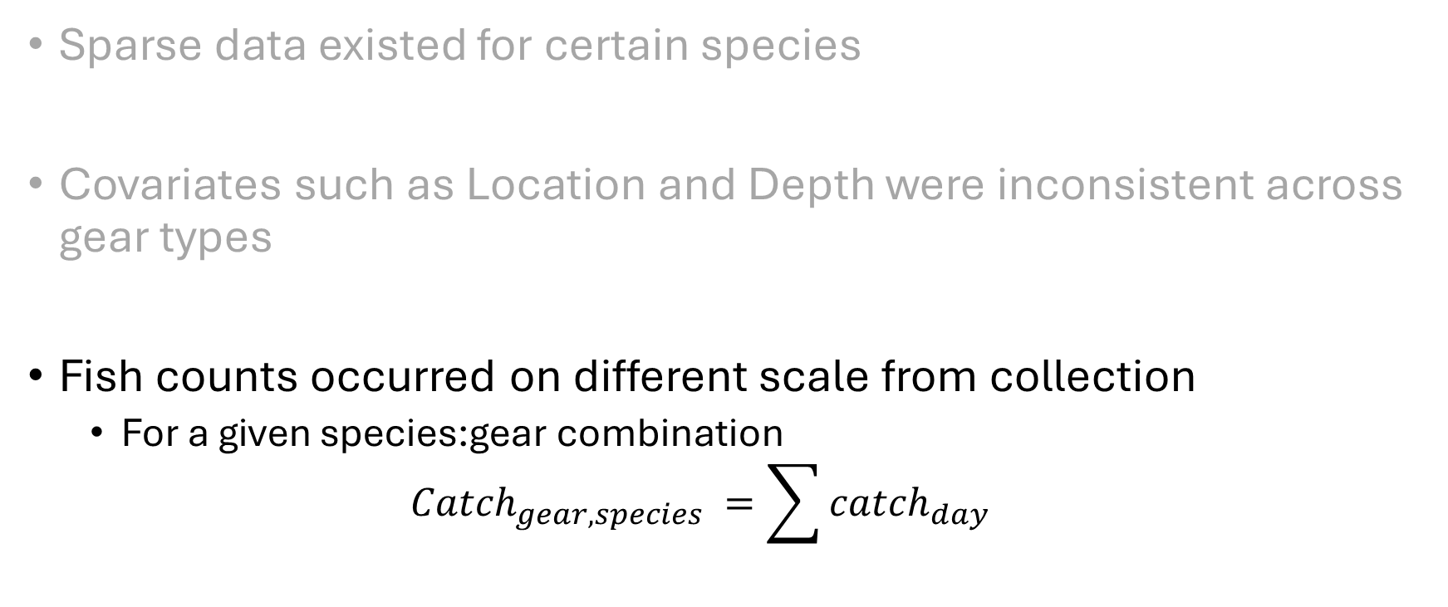
Data limitations
Sparse data existed for certain species
Covariates such as Location and Depth were inconsistent across gear types
Fish counts occurred on different scale from collection
$\text{For} \text{a} \text{given} \text{species}\text{:}\text{gear} \text{combination}$
$${Catch}_{gear,species} =\sum{{catch}_{day}}$$

Slide 16
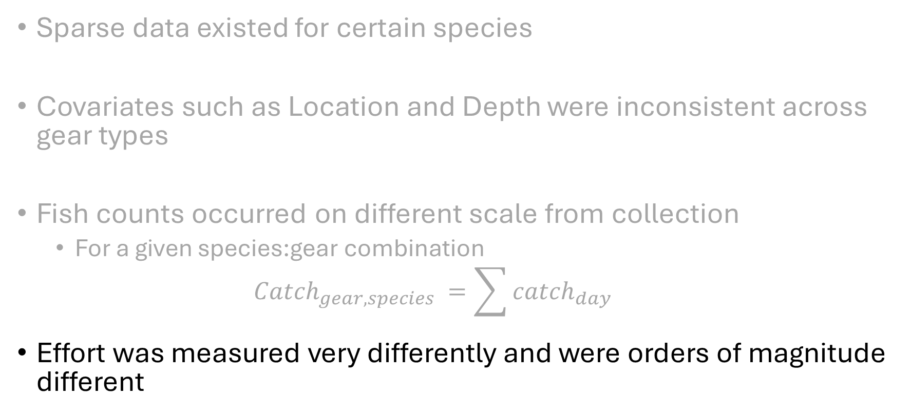
Data limitations
Sparse data existed for certain species
Covariates such as Location and Depth were inconsistent across gear types
Fish counts occurred on different scale from collection
$\text{For} \text{a} \text{given} \text{species}\text{:}\text{gear} \text{combination}$
$${Catch}_{gear,species} =\sum{{catch}_{day}}$$
Effort was measured very differently and were orders of magnitude different

Slide 17
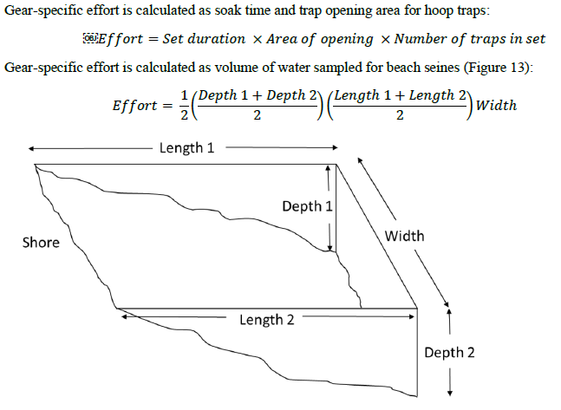
236250 5458127
Ranges
0.13 – 9.3 hours
1198 – 60,244 square foot hours
236,250 – 5,458,127 cubic feet
Electrofishing effort = amount of time electricity applied

Slide 18
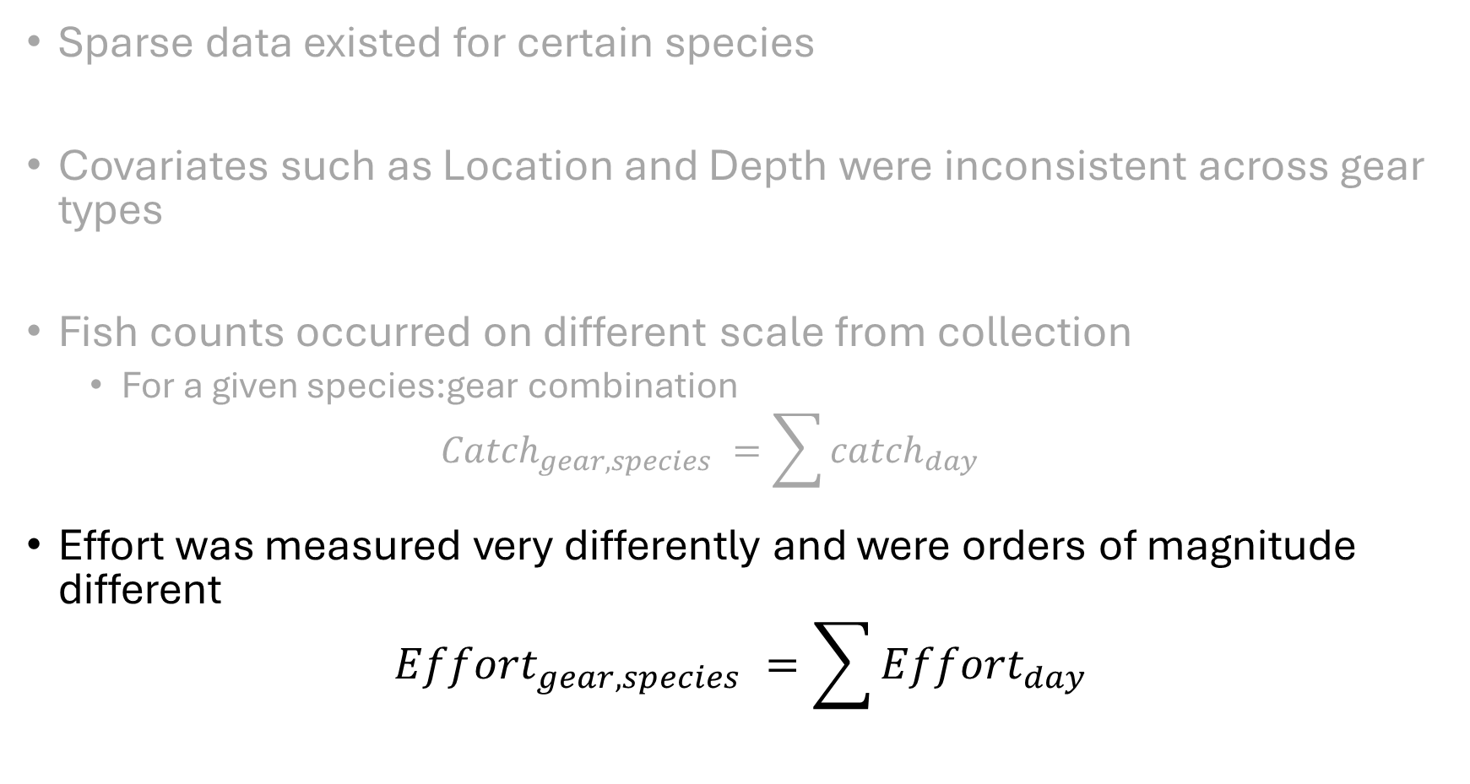
Data limitations
Sparse data existed for certain species
Covariates such as Location and Depth were inconsistent across gear types
Fish counts occurred on different scale from collection
$\text{For} \text{a} \text{given} \text{species}\text{:}\text{gear} \text{combination}$
$${Catch}_{gear,species} =\sum{{catch}_{day}}$$
Effort was measured very differently and were orders of magnitude different
$${Effort}_{gear,species} =\sum{{Effort}_{day}}$$

Slide 19
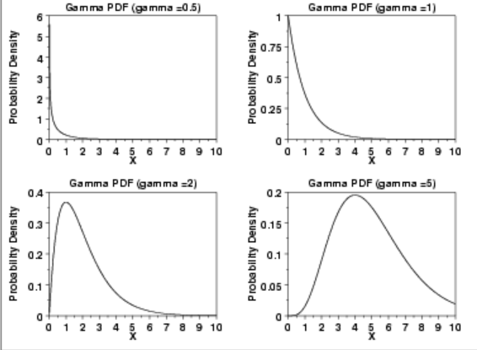
Bayesian hierarchical modeling
Values > 0
cpue ~ 1 + Gear*Species + (1 + Gear + Species | Season),
hu ~ 1+ Gear*Species + (1 + Gear + Species | Season)),
family = hurdle_gamma()
Presence/Absence
Gamma distribution handles positive non-integers
Ex. Time until event

Slide 20
Bayesian hierarchical modeling
Fixed effects
cpue ~ 1 + Gear*Species + (1 + Gear + Species | Season),
hu ~ 1+ Gear*Species + (1 + Gear + Species | Season)),
family = hurdle_gamma()

Slide 21
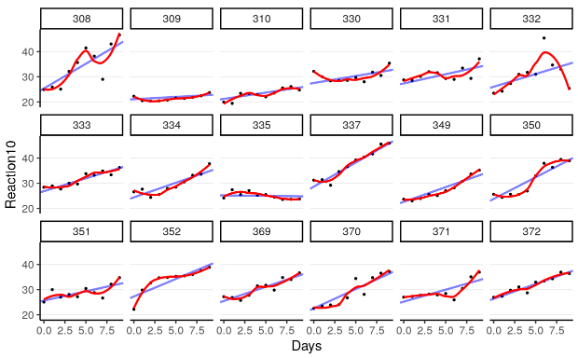
Bayesian hierarchical modeling
Random slope and intercept; grouped by Year
cpue ~ 1 + Gear*Species + (1 + Gear + Species | Season),
hu ~ 1+ Gear*Species + (1 + Gear + Species | Season)),
family = hurdle_gamma()

Slide 22
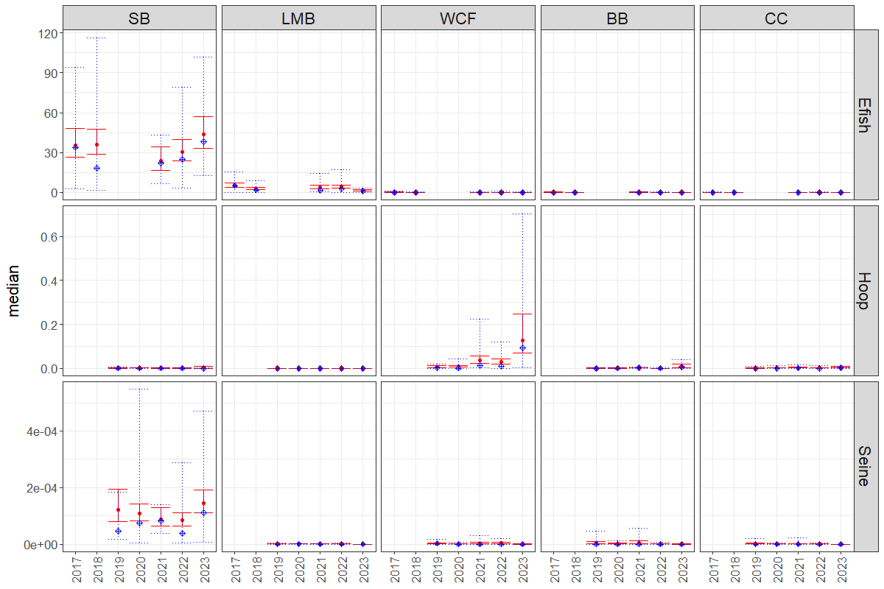
Bayesian hierarchical modeling
Predicted vs Actual
CPUE

Slide 23
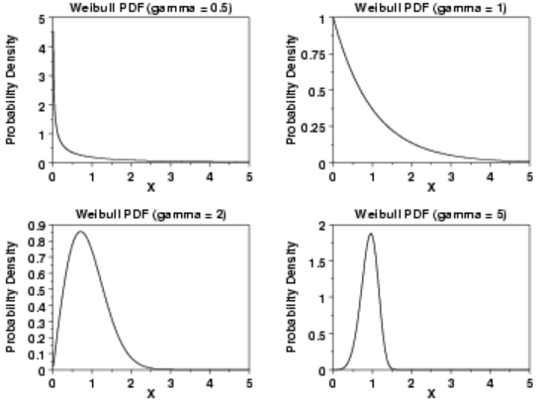
Bayesian hierarchical modeling
cpue ~ 1 + Gear*Species + (1 + Gear + Species | Season),
hu ~ 1+ Gear*Species + (1 + Gear + Species | Season)),
family = hurdle_weibull()
Weibull distribution handles positive non-integers
Ex. Time until event

Slide 24

CPUE

Slide 25
Bayesian hierarchical modeling
catch ~ 1 + effort*Gear*Species + (1 + Gear + Species | Season),
hu ~ 1+ effort*Gear*Species + (1 + Gear + Species | Season)),
family = hurdle_gamma()
Catch is log(catch +1) transformed
Effort is scaled for each gear type

Slide 26
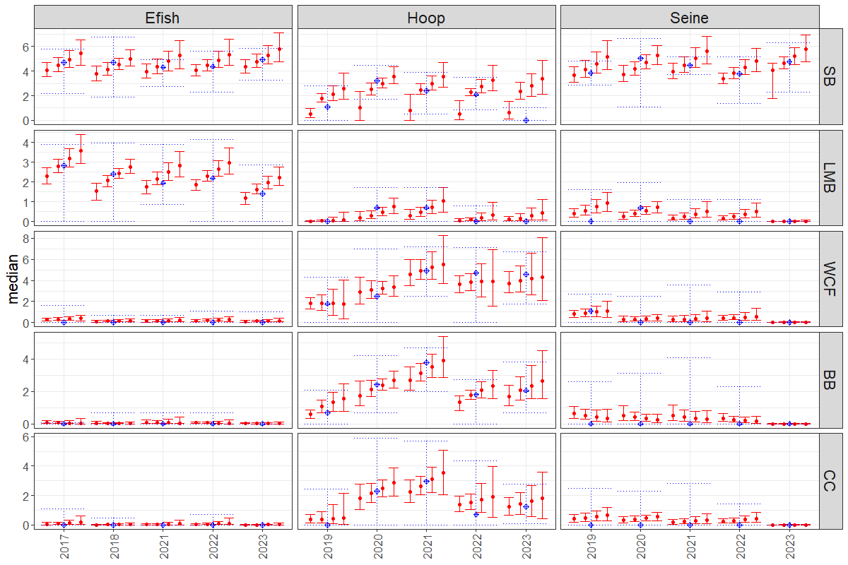
Log(Catch +1)
Predictions split by effort

Slide 27
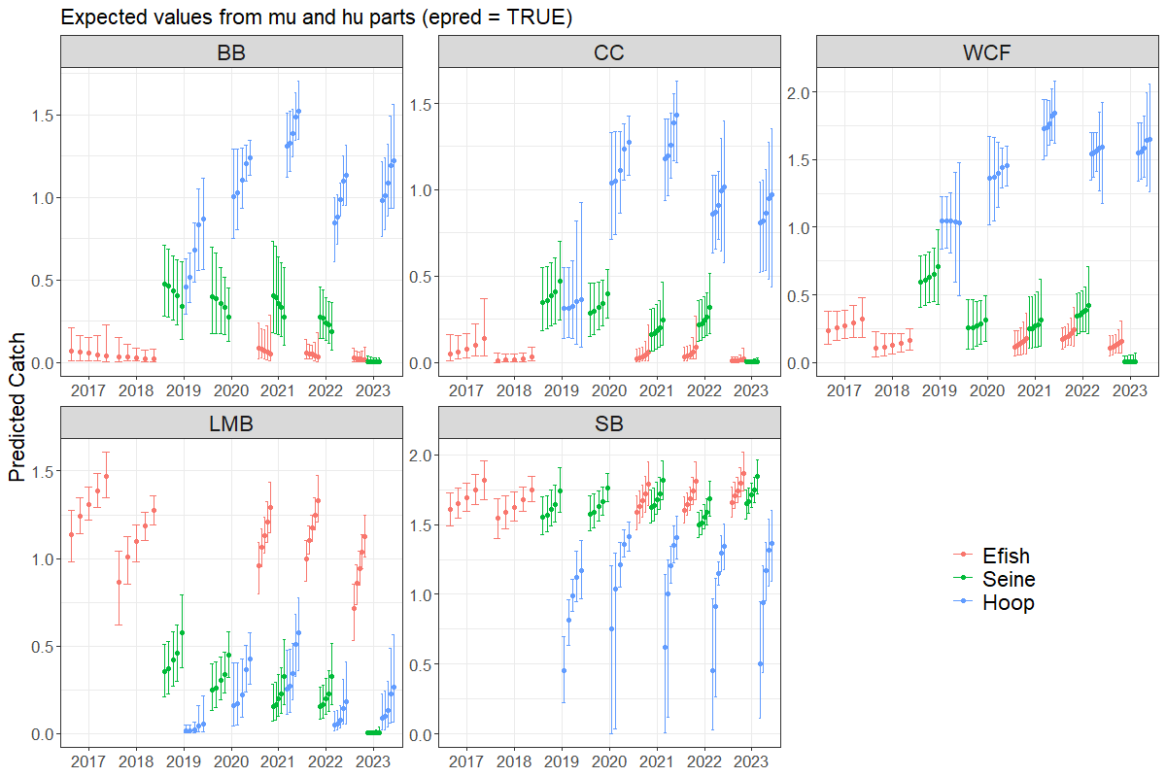
Heiss, Andrew. 2022.
“A Guide to Modeling Outcomes
That Have Lots of Zeros with
Bayesian Hurdle Lognormal and
Hurdle Gaussian Regression
Models.” May 9, 2022.
https://doi.org/10.59350/ety2j-09566.

Slide 28
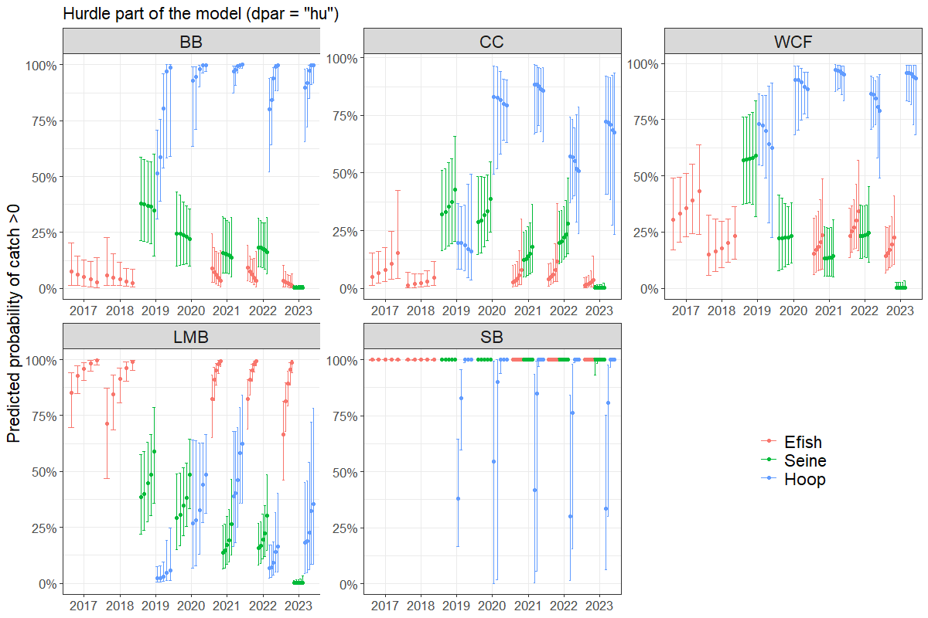
Heiss, Andrew. 2022.
“A Guide to Modeling Outcomes
That Have Lots of Zeros with
Bayesian Hurdle Lognormal and
Hurdle Gaussian Regression
Models.” May 9, 2022.
https://doi.org/10.59350/ety2j-09566.

Slide 29
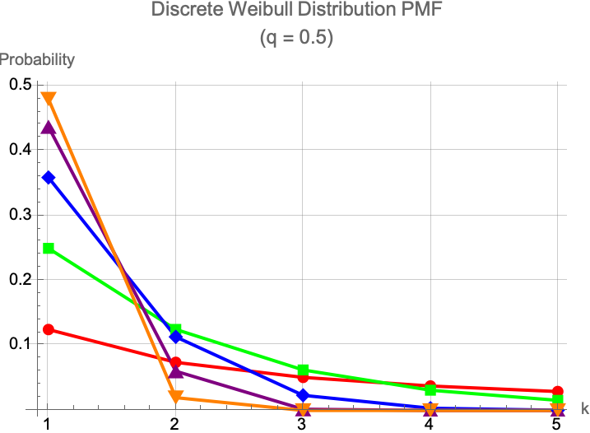
Bayesian hierarchical modeling
catch ~ 1 + effort*Gear*Species + (1 + Gear + Species | Season),
hu ~ 1+ effort*Gear*Species + (1 + Gear + Species | Season)),
family = hurdle_discrete_weibull()
Discrete Weibull distribution handles positive integers
May be preferred when dealing with data that exhibit variability in dispersion (over- or under-dispersion)

Slide 30
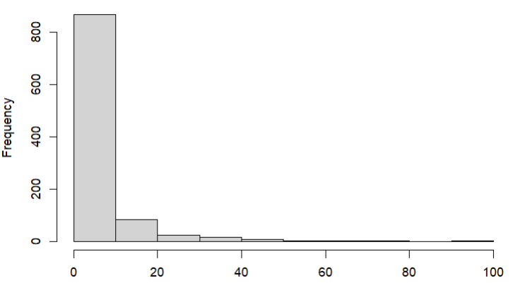
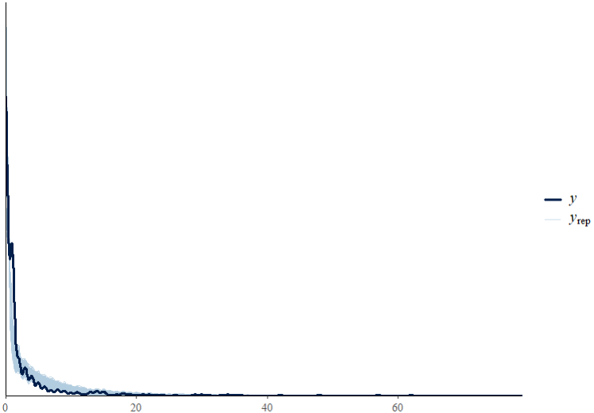
Simulated data from “simple” discrete Weibull distribution

Slide 31
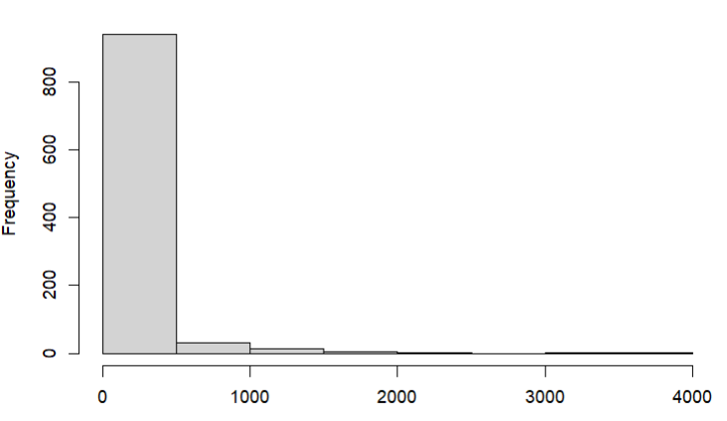
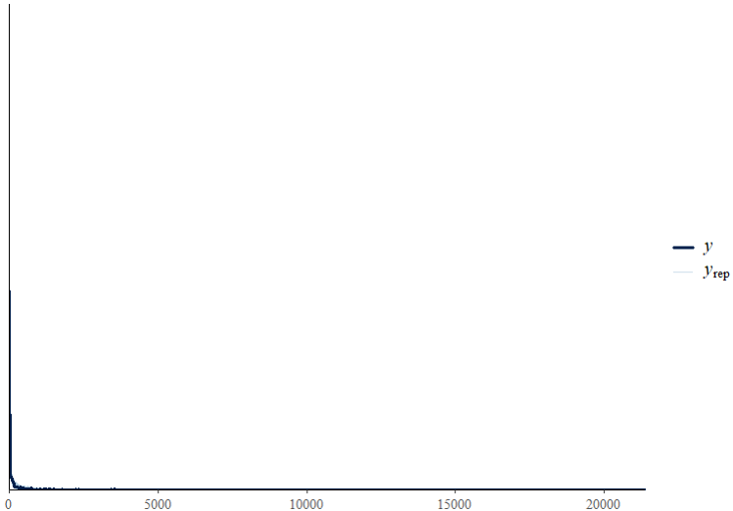
Simulated data similar to predator relocation dataset
Posterior predictive check

Slide 32
Size class analyses
Look at differences in fish sizes caught across gear types
Used NMDS ordination to look at differences gear types

Slide 33
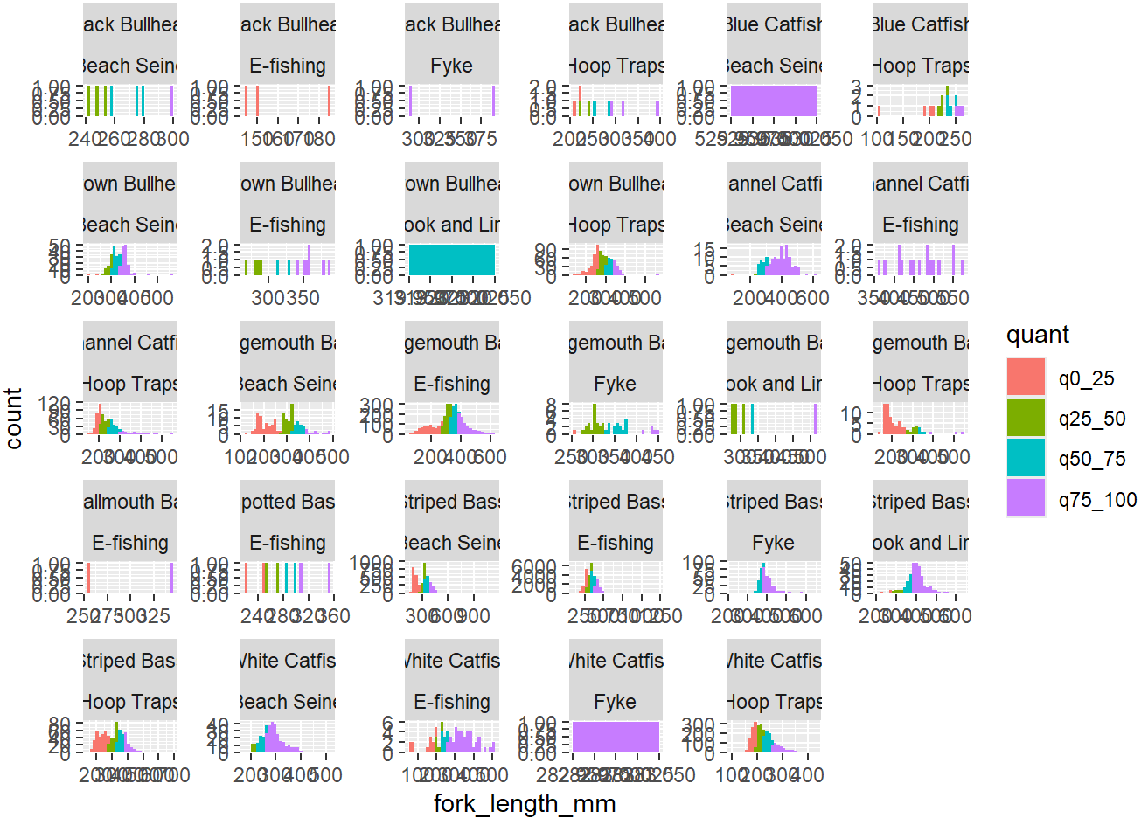
Generated quantiles for each species

Slide 34
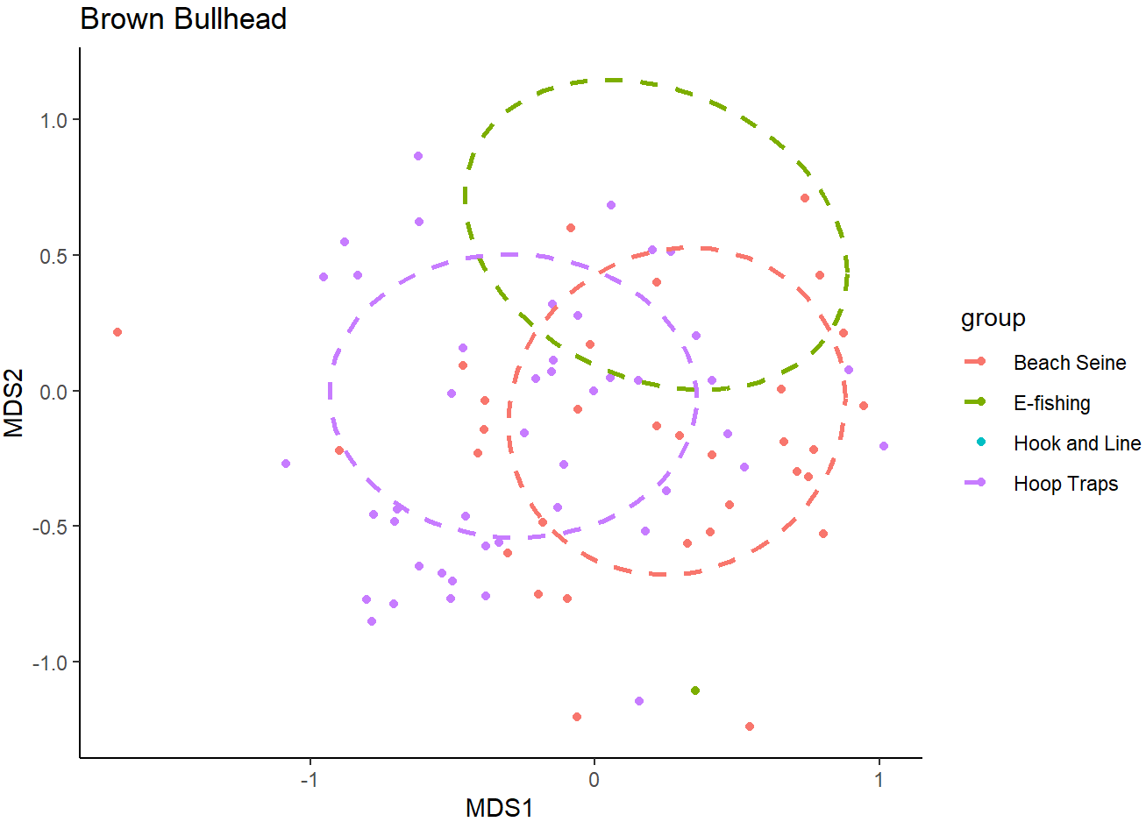

Slide 35
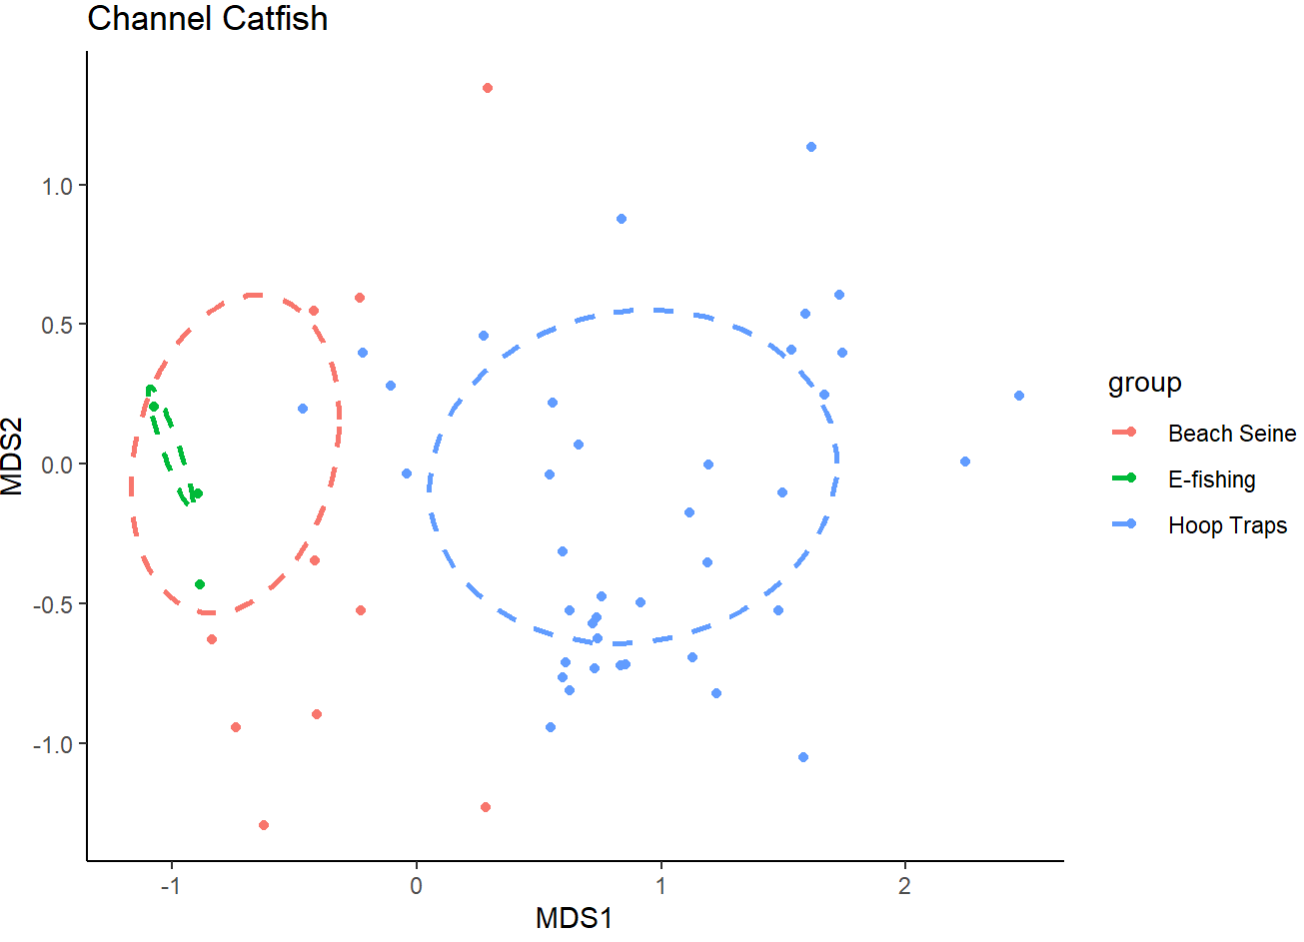

Slide 36
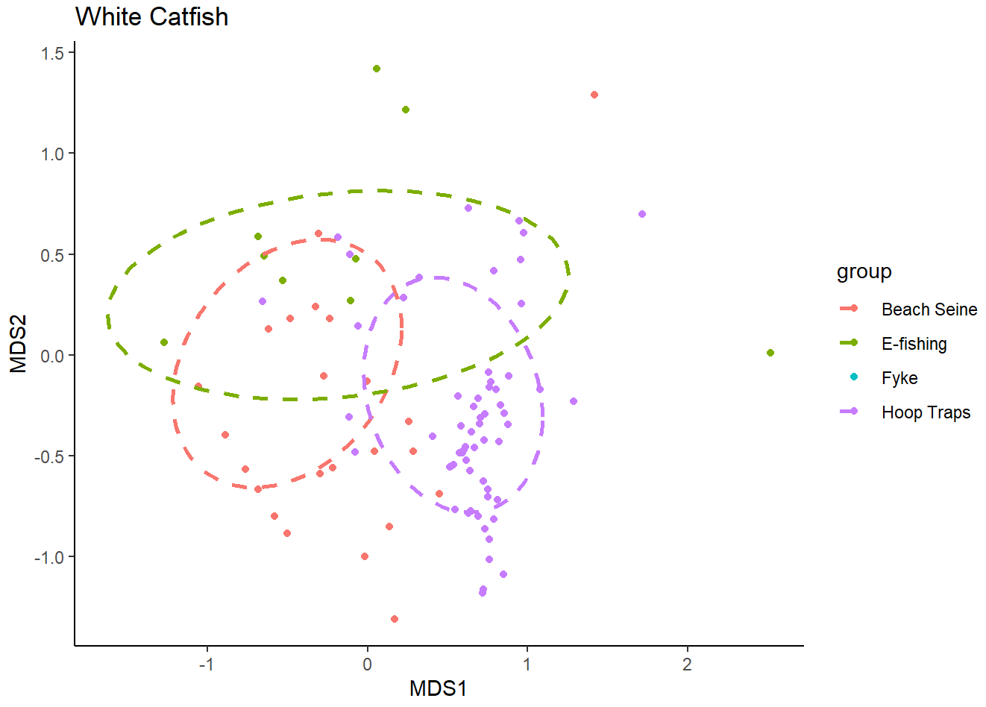

Slide 37
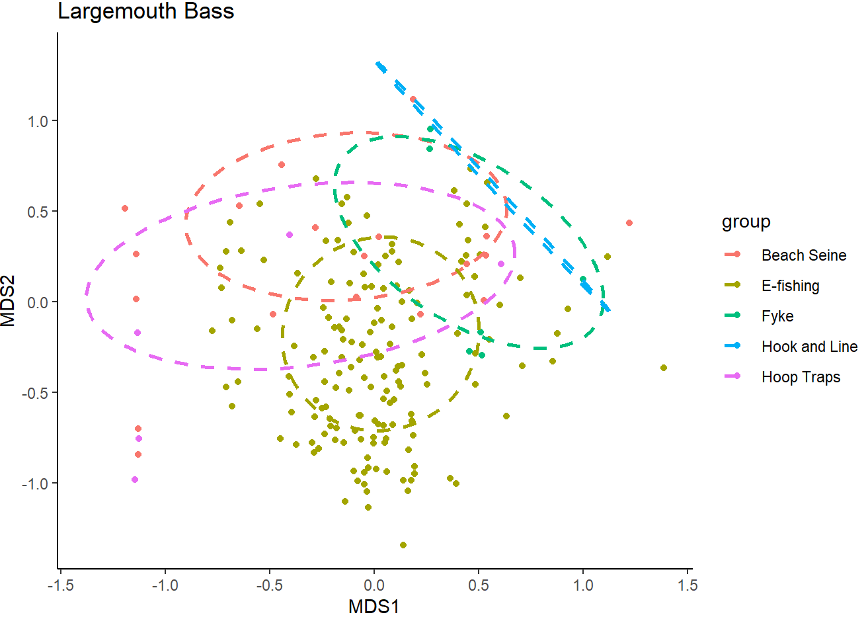

Slide 38
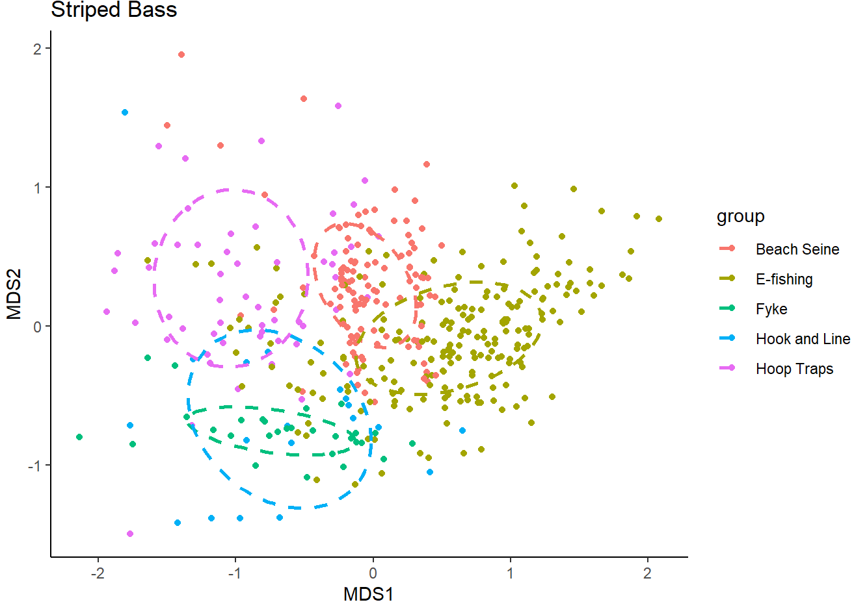

Slide 39
